Slide 1
Handling of
Hazardous substances
Department Keimer
Safety instruction
19th January 2015
________________________________________________________________________________________________________________________
Safety Specialists FKF: Michael Wied, Bernhard Fenk, Martin Siemers

Slide 2
Definition – hazardous substances
Hazardous substances are substances or preparations that have
one or more hazardous characteristics
In total there are 29 hazard classes, among others:
Explosive
Oxidizing
Flammable
Very toxic
Toxic
Corrosive
Sensitizing
Carcinogenic
Toxic for reproduction
Mutagenic
Dangerous for the environment
Compressed gases
________________________________________________________________________________________________________________________
Safety Specialists FKF: Michael Wied, Bernhard Fenk, Martin Siemers

Slide 3
General procedures for handling of hazardous substances
Possibilities of substitution according
GefstoffV §6 paragraph 1 sentence 2 number 4, GefstoffV §7 paragraph 3, TRGS 600
Inform yourself before handling hazardous substances
about:
  risks, dangers,
  protective measures,
  proper disposal and
  behavior in emergency situations
Development of gases, vapors etc. has to be avoided
Contact with hazardous substances has to be avoided
Use suitable personal protective equipment
________________________________________________________________________________________________________________________
Safety Specialists FKF: Michael Wied, Bernhard Fenk, Martin Siemers

Slide 4

Hygienic measures for handling of hazardous substances
!
Foodstuffs, drinks and tobacco must be stored separately from hazardous substances
!
The consumption of food and beverages in chemical
laboratories is prohibited
!
After work and before breaks hands should be washed thoroughly
!
Lab coats must be cleaned regularly and must be exchanged for clean
ones
!
Don’t store liquid hazardous substances in beverage bottles
!
Remove splashes of hazardous substances on the skin
immediately
!
Remove contaminations on lab desks or on equipments immediately with appropriate cleaning agents !!!!
________________________________________________________________________________________________________________________
Safety Specialists FKF: Michael Wied, Bernhard Fenk, Martin Siemers

Slide 5
Personal Protective Equipment for handling of hazardous substances
Use eye and face protection, with:
• defined hazardous substances (e.g. acids, solvents)
• working over head
• Activities with high formation of dust
• Activities with danger of splashing
(Eye bath must be available)
Use appropriate safety gloves, while working with hazardous substances, especially with acids/lyes or solvents
Use safety gloves, if activities might lead to mechanical skin irritations (e.g. activities with fibers, mineral wool by oven building etc.)
Use foot protection when carrying heavy parts
________________________________________________________________________________________________________________________
Safety Specialists FKF: Michael Wied, Bernhard Fenk, Martin Siemers

Slide 6
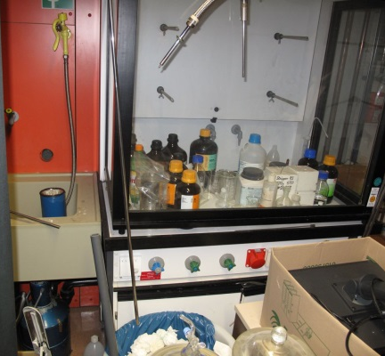
Order and cleanliness in the laboratory
Basic requirement for safe handling of hazardous
substances
  Order and cleanliness in the lab must be observed
Waste materials must be disposed of immediately
  Danger by spilled hazardous substances
Clean work area only with appropriate cleaning aids
  Use of appropriate binding agents
  Avoid to raise dust
Store hazardous substances only in designated rooms
  Safety cabinet
________________________________________________________________________________________________________________________
Safety Specialists FKF: Michael Wied, Bernhard Fenk, Martin Siemers

Slide 7

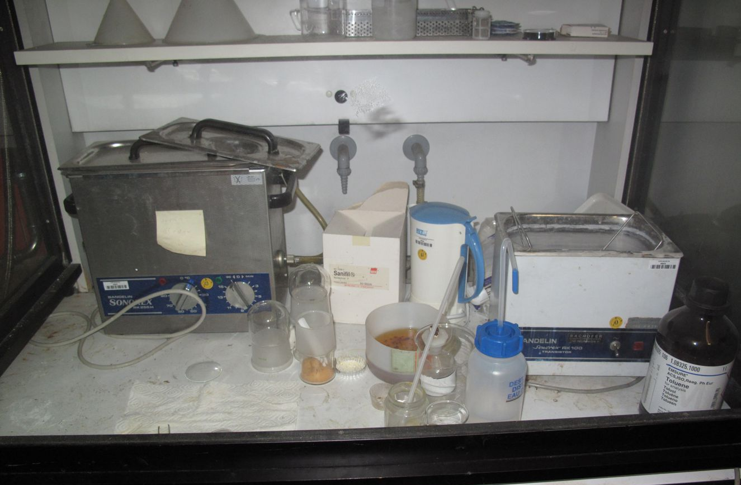
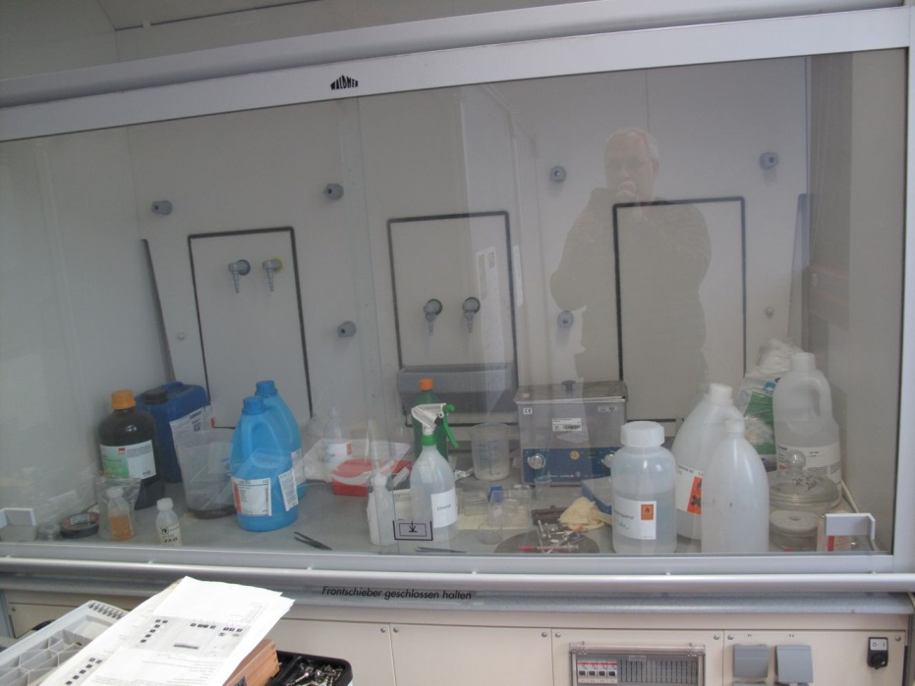
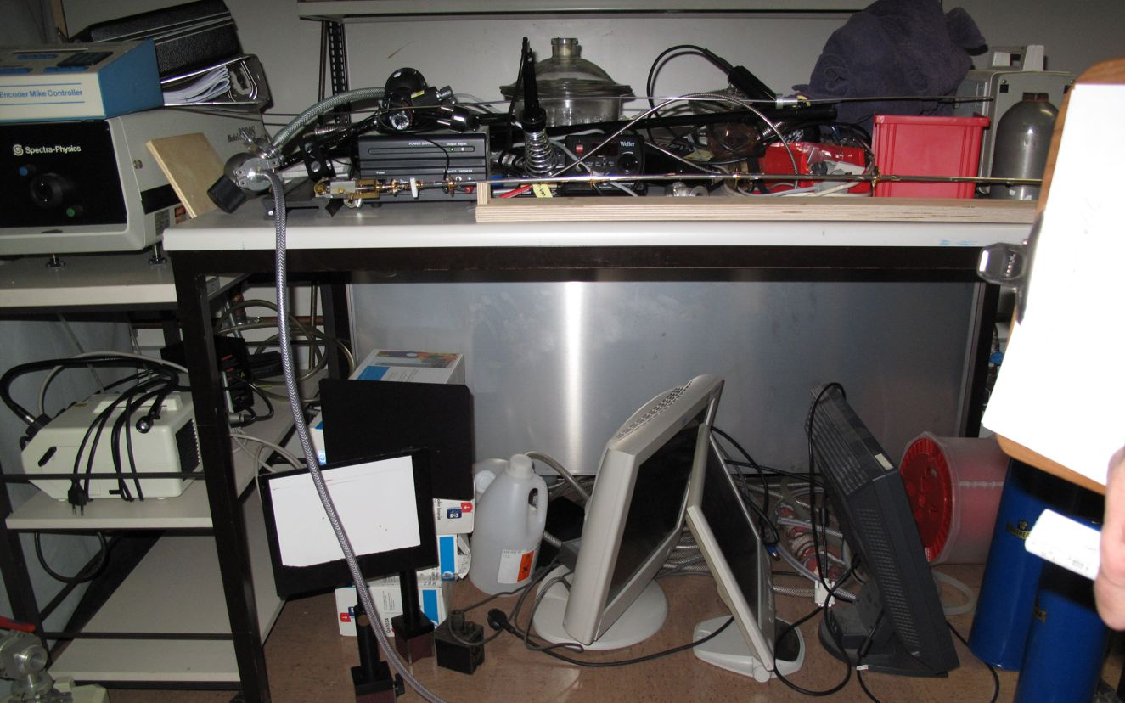
Order and cleanliness in the laboratory
________________________________________________________________________________________________________________________
Safety Specialists FKF: Michael Wied, Bernhard Fenk, Martin Siemers

Slide 8
Possibilities of substituting Methanol by Ethanol
Example: cleaning equipment with Methanol or Ethanol
Check if it is possible to replace Methanol by Ethanol
Vapor pressure 130,3 hPa at 20,0 °C
(Methanol)
Vapor pressure 59,5 hPa at 20,0 °C
(Ethanol)
Methanol has a higher vapor pressure and will be easily breathed in
 | Naturlatex Conform+ Break through time [min] | Nitril Touch‘n‘ Tuff Break through time [min] | Nitril Sol-Vex Break through time [min] | Neopren DermaShield Break through time [min] | PE Barrier Break through time [min]
Methanol | < 10 | 1 | 127 | 18 | > 480
Ethanol | < 10 | 8 | 240-480 | 30-60 | > 480
Methanol penetrates glove material more rapidly than Ethanol
________________________________________________________________________________________________________________________
Safety Specialists FKF: Michael Wied, Bernhard Fenk, Martin Siemers

Slide 9




Hazards of Methanol compared with hazards of Ethanol
Methanol
Ethanol
H225
Highly flammable liquid and vapor.
H301 + H311 + H331
Toxic if swallowed, in contact with skin
or if inhaled
H370
Causes damage to organs.
H225
Highly flammable liquid and vapor.
________________________________________________________________________________________________________________________
Safety Specialists FKF: Michael Wied, Bernhard Fenk, Martin Siemers

Slide 10
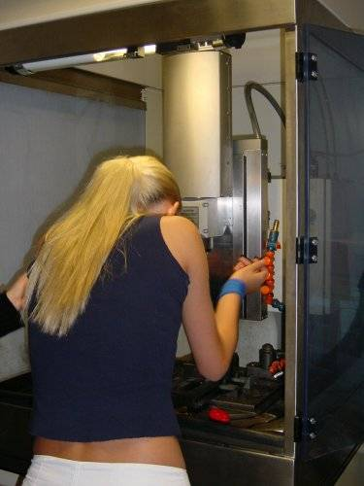
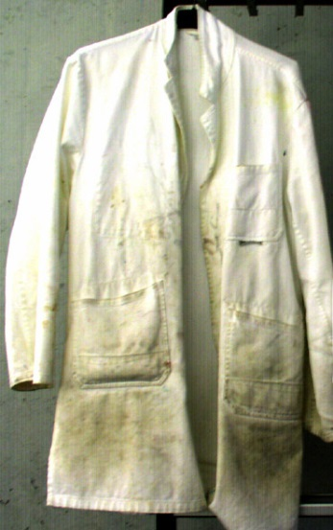
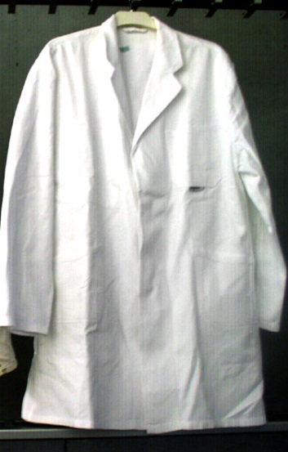

Suitable lab clothes
!
Mandatory to wear while working with chemicals
!
long trouser, lab coat, closed toed shoes, suitable PPE
and not in offices / rest areas
(Carry-over of hazardous materials, also possible by gloves!)
Change and new lab coats:
Room 2 M 10;
Mo, We, Fr 9:30 am. – 11:30 am.
Not this way!
________________________________________________________________________________________________________________________
Safety Specialists FKF: Michael Wied, Bernhard Fenk, Martin Siemers

Slide 11
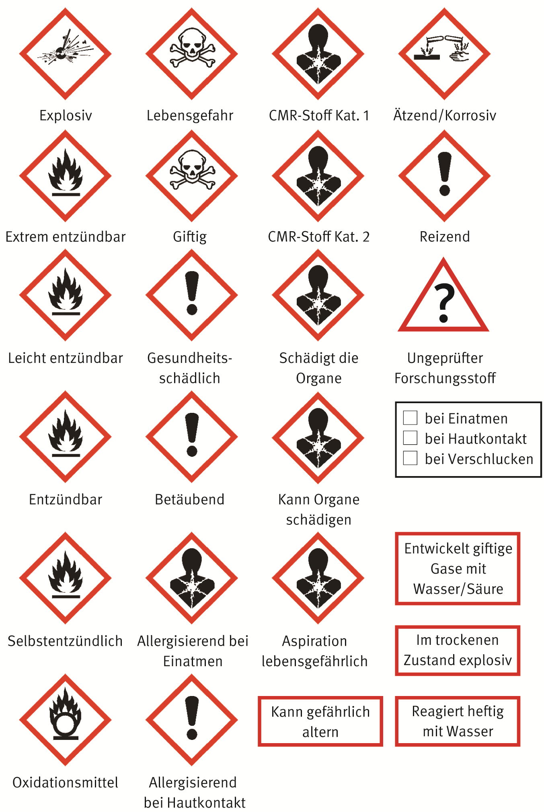

GHS – Simplified labeling in laboratories
GHS – Simplified labeling in laboratories
Proposal of the AK Laboratories for the in-
house labeling of lab-jars
Name of substance
Hazard pictogram on adhesive label
Short version of H-Statement below
the pictogram
Priority rule with at most 3 pictograms
GHS09 must not be used
________________________________________________________________________________________________________________________
Safety Specialists FKF: Michael Wied, Bernhard Fenk, Martin Siemers

Slide 12
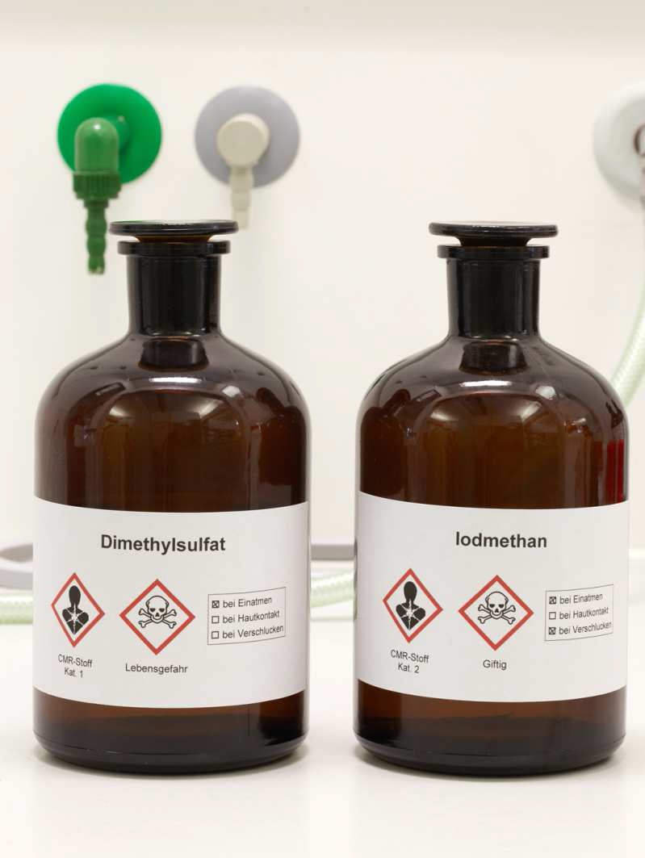
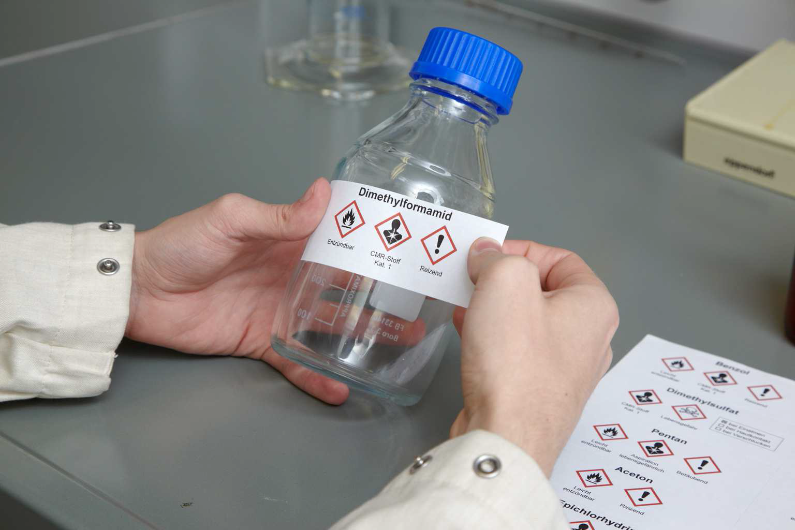
GHS – Simplified labeling in laboratories
GHS – Simplified labeling in laboratories
________________________________________________________________________________________________________________________
Safety Specialists FKF: Michael Wied, Bernhard Fenk, Martin Siemers

Slide 13

GHS – Simplified labeling in laboratories
GHS – Simplified labeling in laboratories
Simplified labeling for products for scientific research
No test data? Handle like:
Acute Toxicity Cat. 3 (H331, H311, H301)
Skin irritation Cat. 2 (H315)
Mutagenicity Cat. 2 (H341)
Skin sensitizer Cat. 1 (H317)
Untested
research
substance
________________________________________________________________________________________________________________________
Safety Specialists FKF: Michael Wied, Bernhard Fenk, Martin Siemers

Slide 14

Questions?
________________________________________________________________________________________________________________________
Safety Specialists FKF: Michael Wied, Bernhard Fenk, Martin Siemers

